Slide 1
19CSE312 -Distributed Systems
Distributed Shared Memory(DSM)

Slide 2
Introduction
A distributed shared memory is a mechanism allowing end-users' processes to access shared data without using inter-process communications.
shared memory model provides a virtual address space shared between all nodes
How
Data moves between main memory and secondary memory (within a node) and between main memories of different nodes
Each data object is owned by a node :Initial owner is the node that created object Ownership can change as object moves from node to node
When a process accesses data in the shared address space, the mapping manager maps shared memory address to physical memory (local or remote)

Slide 3
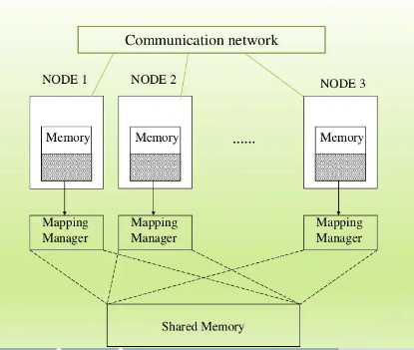

Slide 4
Advantages
Data sharing is implicit, hiding data movement.
Passing data structures containing pointers is easier.
Moving entire object to user takes advantage of locality difference
Less expensive to build than tightly coupled multiprocessor system.
Very large total physical memory for all nodes: Large programs can run more efficiently
No serial access to common bus for shared physical memory like in multiprocessor systems
Programs written for shared memory multiprocessors can be run on DSM systems with minimum changes

Slide 5
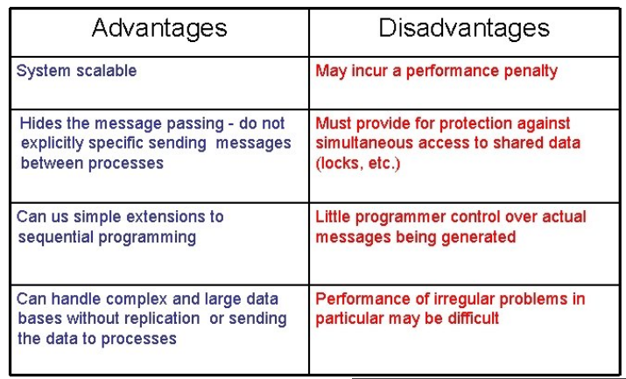
Advantages vs Disadvantages

Slide 6
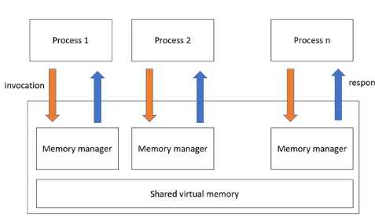

Slide 7
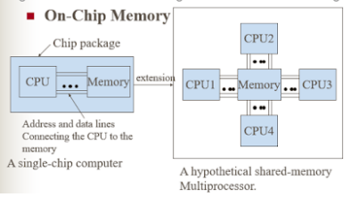
Types of Distributed shared memory
On-Chip Memory
The data is present in the CPU portion of the chip.
Memory is directly connected to address lines.
On-Chip Memory DSM is expensive and complex.
Such chips are widely used in appliances cars and even toys.

Slide 8
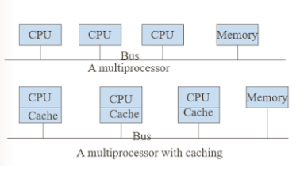
Bus-Based Multiprocessors
A set of parallel wires called a bus acts as a connection between CPU and memory.
accessing of same memory simultaneously by multiple CPUs is prevented by using some algorithms
Cache memory is used to reduce network traffic.

Slide 9
Ring-Based Multiprocessors
There is no global centralized memory present in Ring-based DSM.
All nodes are connected via a token passing ring.
In ring-bases DSM a single address line is divided into the shared area.
A single address line is partitioned into a private area and shared area.
Private area is divided up into regions so each machine has a piece for its stack
Shared area is divided into 32 byte blocks.
All machines are connected via token passing ring. All components are interconnected via Memnet device.
No centralized global memory.

Slide 10
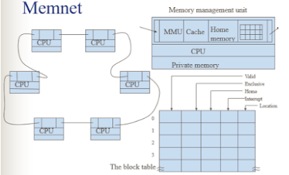

Slide 11
Switched Multiprocessors
Two approaches can be taken to attack the problem of not enough bandwidth.
Reduce the amount of communication. E.g. Caching.
One method is to build the system as a hierarchy. Build the system as multiple clusters and connect the clusters using an intercluster bus. As long as most CPUs communicate primarily within their own cluster, there will be relatively little intercluster traffic. If still more bandwidth is needed, collect a bus, tree, or grid of clusters together into a supercluster, and break the system into multiple superclusters.

Slide 12
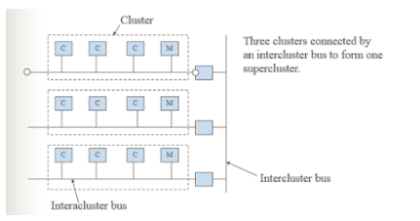
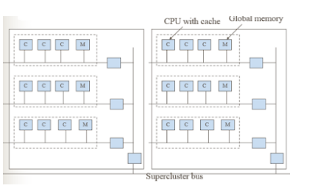

Slide 13
Implementing DSM
Hardware layer
Special network interfaces and cache coherence circuits
Software layer
Page based=> Using systems virtual memory
Shared variable based=> Using routine to access shared variable
Object based=> Shared data within the collection of objects

Slide 14
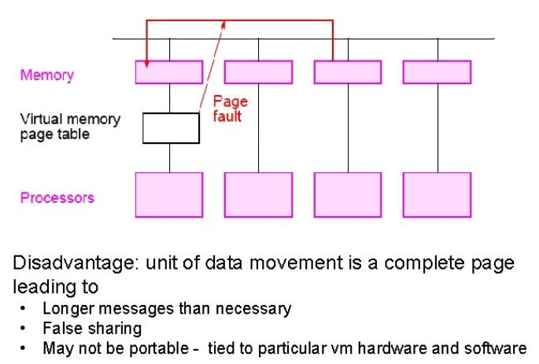
Page based DSM

Slide 15
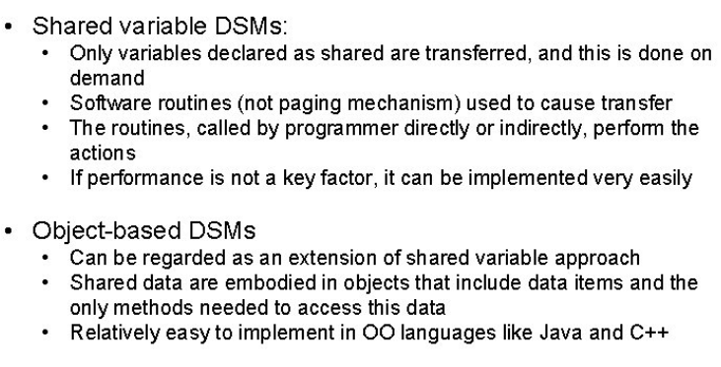
Shared variable vs Object based

Slide 16
Managing Shared Data
A processor can get access to shared data by having
A centralized server
Multiple copies of shared data
In the first solution, a centralized server is responsible for all read/write operations on shared data
All reads/writes of shared data occur in one place and sequentially
Implements a single reader/single writer policy
Rarely used because of server bottleneck
The second solution implements a multiple reader/single writer policy, allowing simultaneous access to shared data
Achieved by replicating data at required sites
Only one site (the owner) is allowed to alter shared data
In the multiple reader/single solution, one of the following coherence policies can be used when owner modifies shared data • Update policy • Invalidate

Slide 17
Achieving Consistent Memory in a DSM System
Strict Consistency
Processors see most recent update, returns the most recent wrote to location. i. e. read
Relaxed Consistency
Delay making write visible to reduce messages.
Weak consistency
Programmer must use synchronization operations to enforce sequential consistency when necessary.
Release Consistency
Programmer must use specific synchronization operators, acquire and release.
Lazy Release Consistency
update only done at time of acquire.

Slide 18
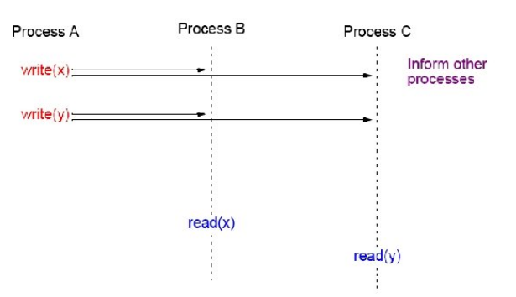
Strict consistency
Every write immediately visible
Disadvantages
number of messages, latency, maybe unnecessary.

Slide 19
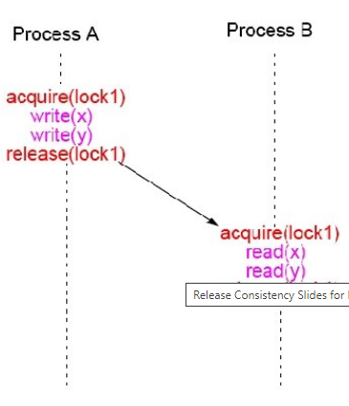
Release Consistency
An extension of weak consistency in which the synchronization operations have been specified:
acquire operation - used before a shared variable or variables are to be read.
release operation - used after the shared variable or variables have been altered (written) and allows another process to access to the variable(s)
Typically acquire is done with a lock operation and release by an unlock operation (although not necessarily).

Slide 20
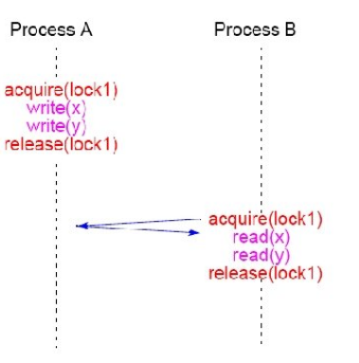
Lazy Release Consistency
Advantages: Fewer messages

Slide 21
DSM Programming Systems
Four necessary operations that must be provided in shared memory programming:
Process/thread creation (and termination)
Shared-data creation
Mutual-exclusion synchronization
Process/thread and event synchronization
These have to be provided in a DSM system also, typically by user-level library calls

Slide 22
DSM Implementation Projects Using underlying message-passing software
Basic shared-variable implementation can be easy to do
Can sit on top of message-passing software such as MPI.
Issues in Implementing a DSM System
Managing shared data - reader/writer policies
Timing issues - relaxing read/write orders
Reader/writer policies
Single reader/single writer policy - simple to do with centralized servers
Multiple reader/single writer policy - again quite simple to do
Multiple reader/multiple writer policy - tricky

Slide 23
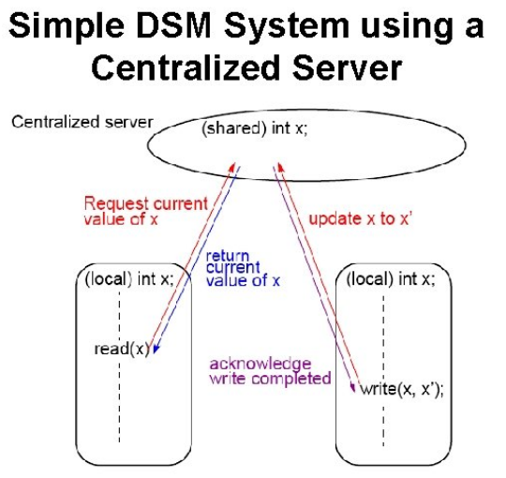

Slide 24
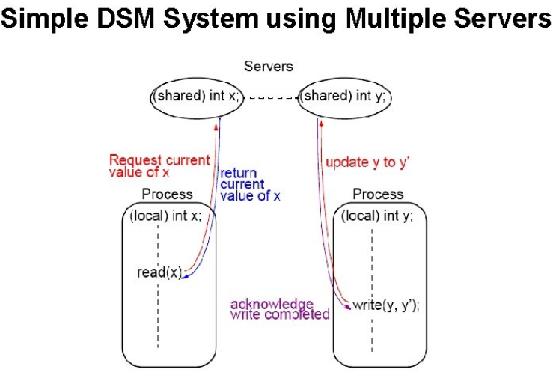

Slide 25
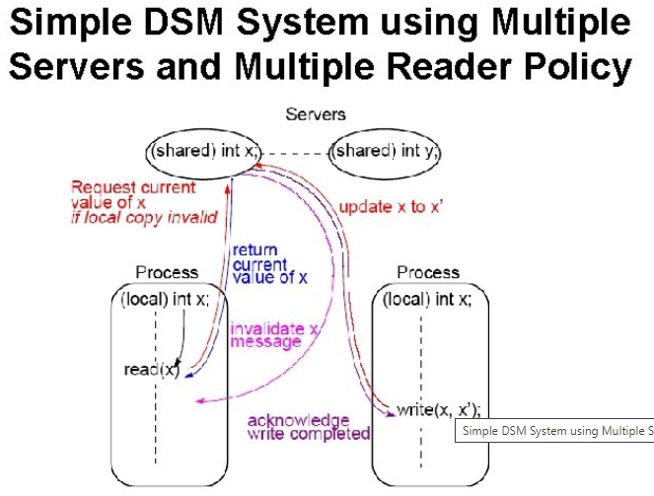

Slide 26
THANK YOU

